Slide 1
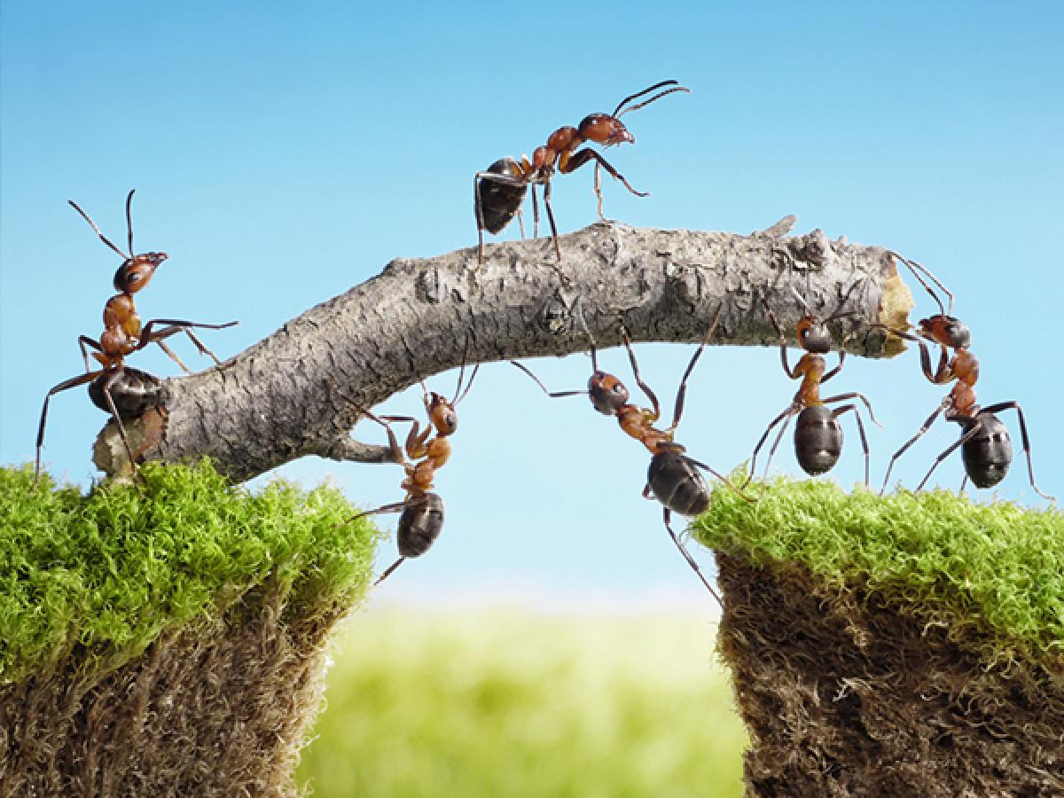
Challenges of delegation & building a team

Slide 2
Tasks
Identify your tasks
Choose tasks you could/wish to delegate
Choose 2/3 of tasks to delegate
Describe the task and skills required to take over the task
Try to delegate
Notes:
Tools needed: print out „My tasks” for everyone – provide pen and scissors, team members should have their phones to take photos
Make a list of tasks you do -> Take a photo
Select the ones you think someone else could do or you wish someone else would do instead of you -> Cut these out (Put the first cut outs separately!) -> Take a photo. How many tasks do you have left?
Now you shall prioritize- which tasks are the most important?
Cut out 2/3 of your total tasks. How many did you cut out in total and how many left? -> Take a photo
The final cut are the tasks an EC organizer needs to delegate within the range of the 4 years of preparation - the remaining will be their focus that they will need to deal with in details.
The first cut outs are like the tasks we usually delegate to YEMPers.
5. Look at the tasks you first cut out. Choose one task and make a short description of the task, plus define the skills/experience a person needs to be able to do this task
6. Choose someone from the group and try to find out if this person could do this task and try to delegate the task to this person. Share what you experienced: could you delegate the task? If yes: why? If no: why?
-> Importance of task identification, description -> Importance of selection

Slide 3
Organigramme &
YEMP tasks

Slide 4
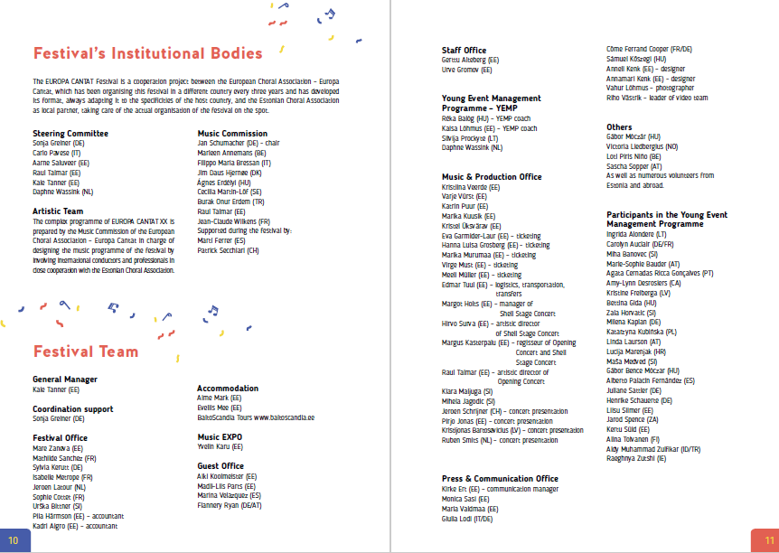

Slide 5
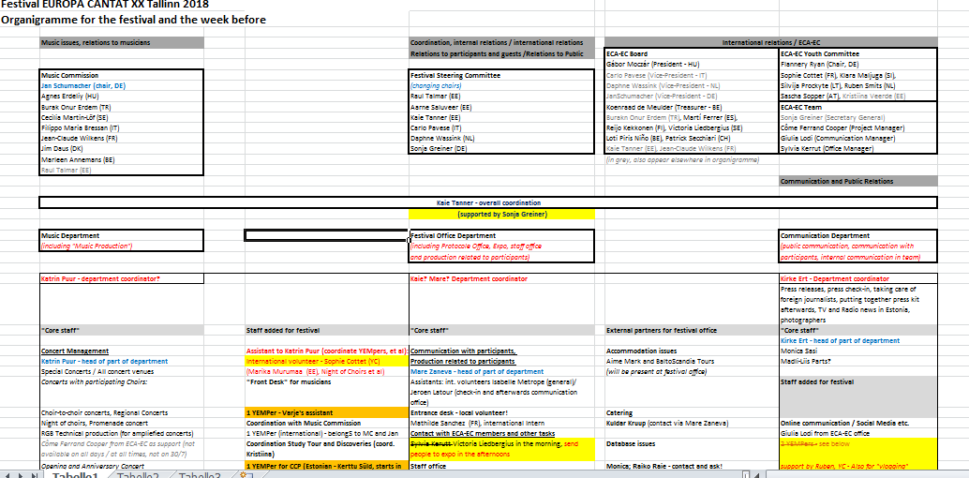
Organigramme
Notes:
Shared the printed version

Slide 6
YEMP Tasks 2018
Music Office (14 YEMper):
Font Desk for musicians 1 YEMPer Invited choirs 1 YEMPer (strong personality & professional approach) Choir-to-choir concerts etc. 1 YEMPers
Coordination MC 1 YEMPer Open Singing (Donati/Merzi) 2 YEMPers (strong personality for Donati)
Coordination Study Tour 1 YEMPer
Venue Managers 4 YEMPers
Specific: Stage Town Hall Sq. 1 YEMPER
CCP / Discovery Ateliers 2 YEMPers (one with technical skills for CCP)
Festival Office (7 YEMPers)
Festival Office (info & merchandising etc.) 3 YEMPers
Protocol Office 1 YEMPer
Concert Tickets 1 YEMPer
Coordination of transportation 1 YEMPer
Check-in and Internal communication 1 YEMPer
Communication Office (3 YEMPers):
Managing Screen in Russian Cultural Centre & Communication with Participants 1 YEMPer
Webstreaming, filming 2 YEMPers

Slide 7
Game on distribution of tasks
Make teams of 3-6 persons
Select your team leader who will delegate tasks
Follow your team leaders instructions
Notes:
Tools needed: print out „Pictures for distribution of tasks game”, team leadres should have their phones to take photos, provide some accessories if needed (umbrella, paper, scotch tape)
Select photos/paintings. Instruct the team leaders that they need to recreate the photo/painting with the team members by turning their back to their team and needing to explain them what they shall do without being able to see what they are doing. One they feel they are ready, they shall turn back and take a photo. If they are not happy with the results, they have one more chance to correct them. The second photo shall be the final result of the task. The team has 10 minutes to deliver the photos.

Slide 8
Distribution of tasks
Learn to let go
Establish a priority system
Play to your workers' strengths
Always include instructions
Don't be afraid to teach new skills
Trust, but verify
Use feedback to improve delegation moving forward
https://www.inc.com/jayson-demers/7-strategies-to-delegate-better-and-get-more-done.html

Slide 9
Building a team
Respect
Communication
Diversity
Trust
Common goal
Food-> basic needs ok
Clear responsibilities
Shared values
Constructive criticism
Take good care of yourself
Attention to others
Notes:
YEMPers think these are needed to build a good team

Slide 10
Building a team
Teambuilding for your staff
Get out of office environment
Share your fears

